Slide 1
BEYOND MOBILE TICKETING
PARKING, PREMIUM, HOSPITALITY, AND MORE

Slide 2
MODERATORS
Ryan Miller, Paciolan
PRESENTERS
Jeff Rubin, Sidearm Sports
Chris Elliston, ParkHub
McK Williams, Oklahoma

Slide 3
Mobile Fan Engagement Strategy
Consumer Experience
Revenue Generation
Fan Education

Slide 4
Mobile Evolution
148 clients are mobile first
48 clients have launched the Sidearm App SDK
41 since the start of 2020 football season
50 clients have partnered with ParkHub
33 since the start of 2020 football
41 clients have implemented paperless invoicing
32 have turned on the Required Seat Donation Functionality
33% of transfers result in new account creation in database

Slide 5
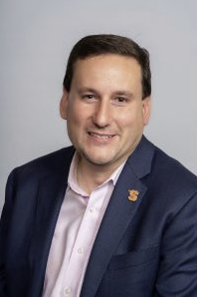
Jeff Rubin
SIDEARM Sports

Slide 6
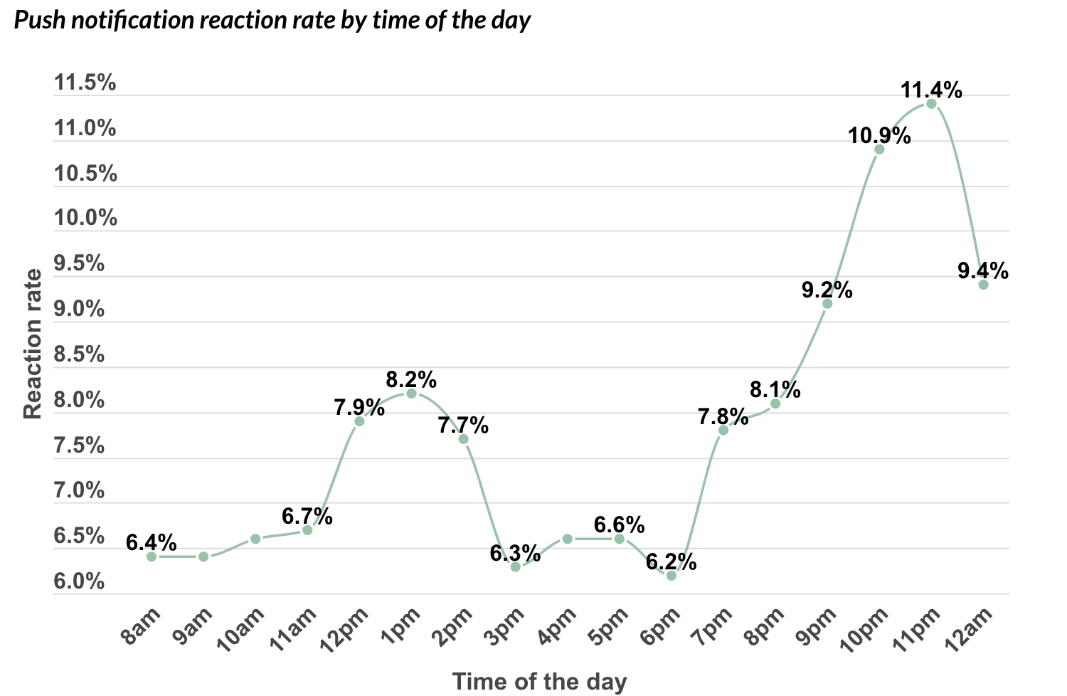
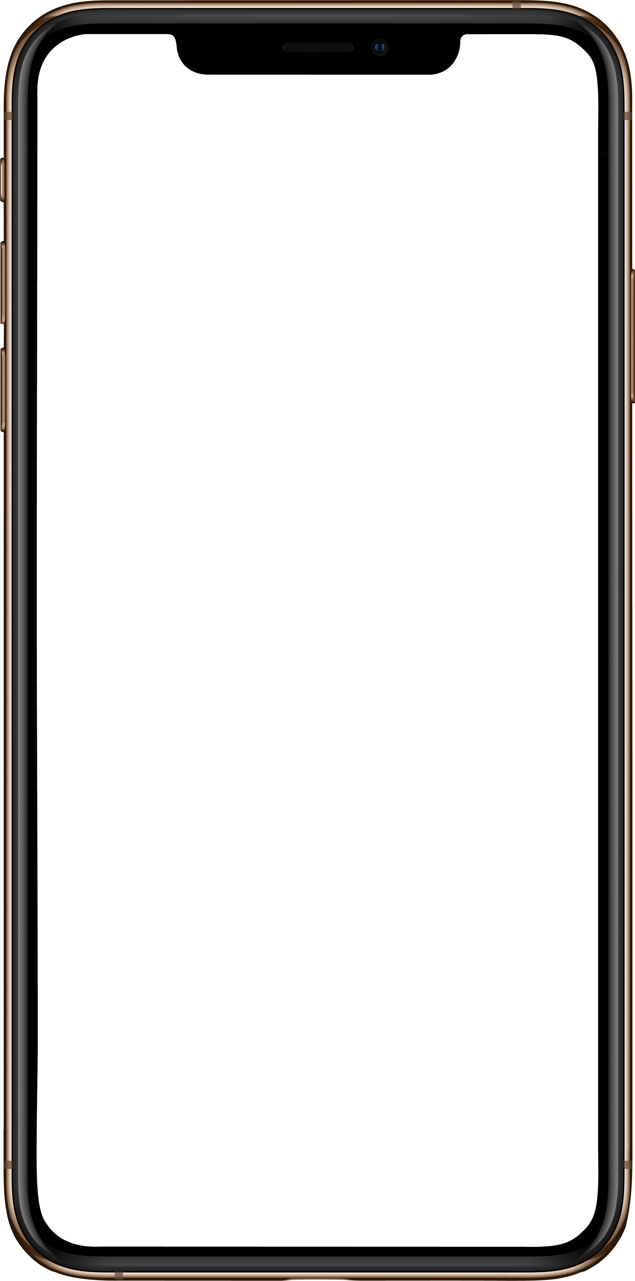
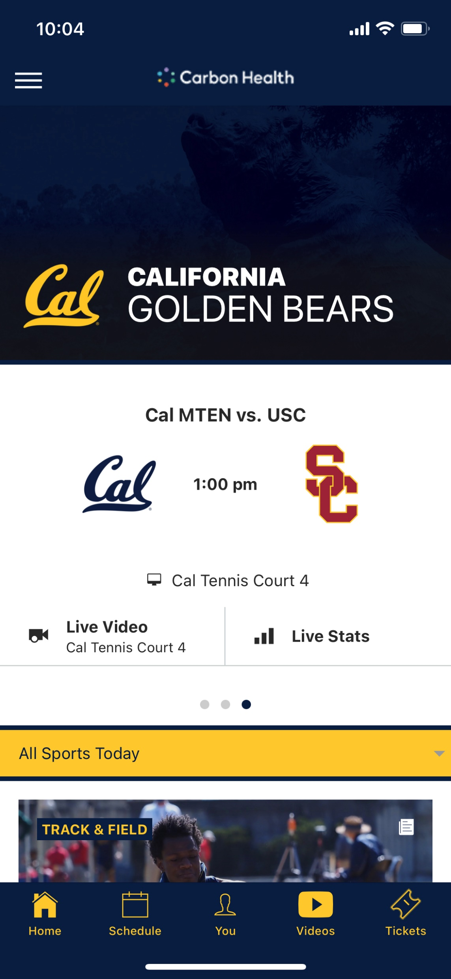
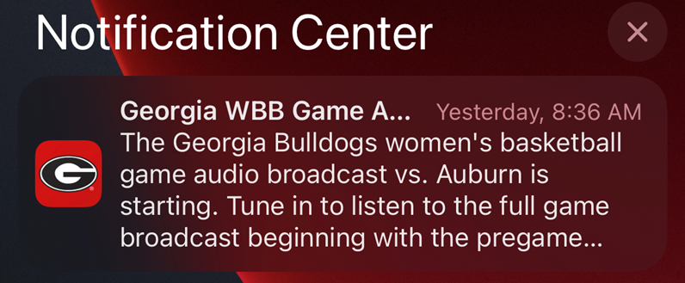
Returning to Live Events
Increased demand for
SIDEARM Mobile App
Push Notifications
  #1 way to engage fans in 2022
  Increase App retention rates by 10x

Slide 7
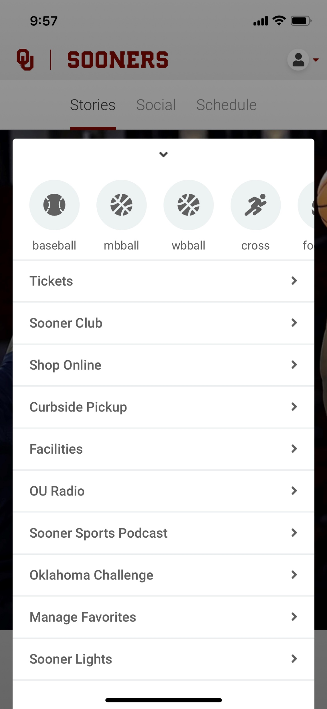
Complete One Stop Shop
Additional Opportunites Within the App
  Paciolan – Continued Co-Development
  Mobile Concessions / Merchandise
  Fan Loyalty (Fan Maker)
  Light shows
  Augmented Reality
  Predictive Play

Slide 8


Monetizing Fan Engagement
How can we engage fans outside the traditional ticket model?
  Fan Loyalty Programs
    – Utilize Social Media and Scan Data
  Predictive Play
  NFTs
  Social Sharing
  Advertising / Sponsorship

Slide 9
What’s Next?
SIDEARM Next Gen Native App (Mobile & OTT)
-Enable Native Phone Features; Deeper Integrations
Investment in first party data solutions
– Cookiepocalypse; Apple IDFA; Authentication Walls
NIL, NFT, and Sports Wagering Predictive Play

Slide 10
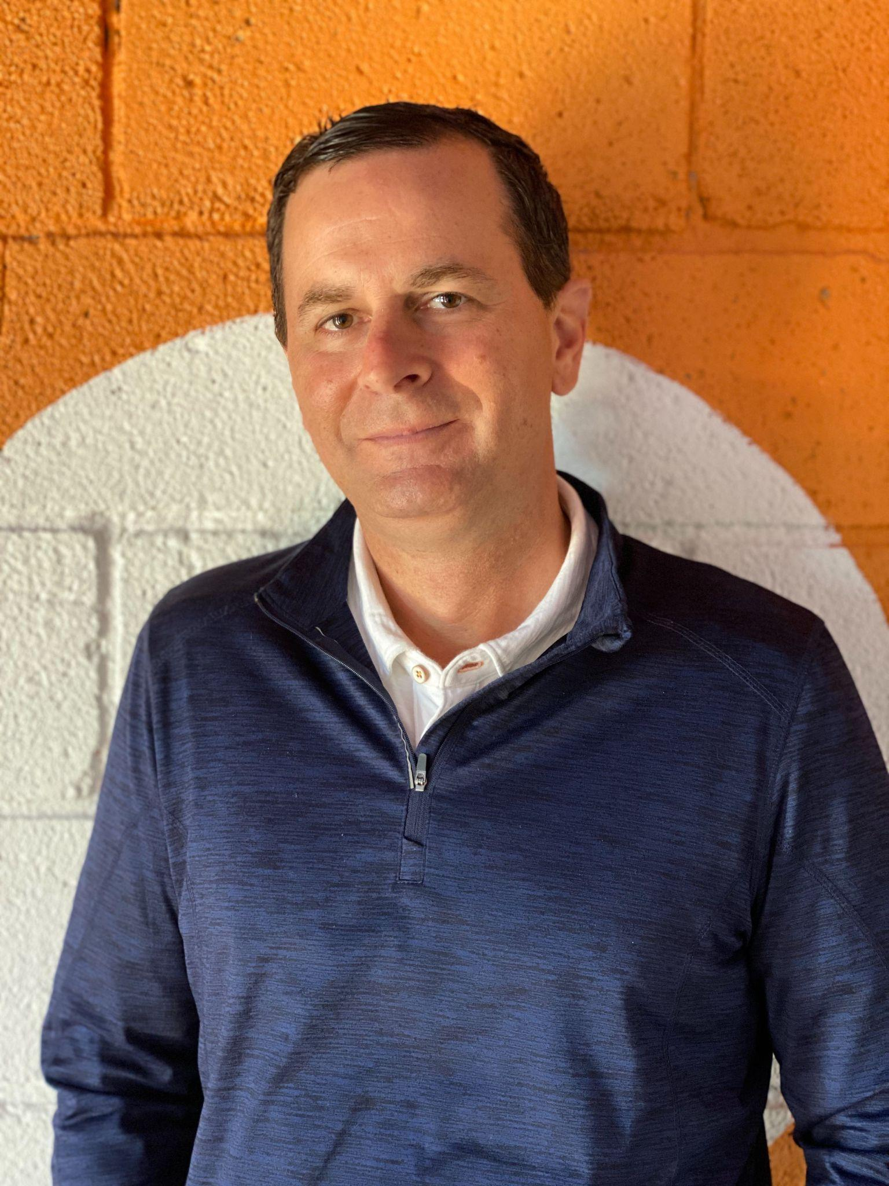
Chris Elliston
EVP, ParkHub

Slide 11




Enabling change.
Beyond Mobile Ticketing | ParkHub
REVOLTUTION 1.0
1750 - 1850
PROBLEMS:
Transportation of Goods
Communication
Food storage
REVOLTUTION 2.0
1900 - 1950
PROBLEMS:
Personal travel
Barriers to Land Travel
Cooking Speed
REVOLTUTION 3.0
1970 - 2000
PROBLEMS:
Lack of Access to Info
Libraries/Newspapers
Communication speed
REVOLTUTION 4.0
2001 - present
PROBLEMS:
Communication
Labor shortages
Consumer demand
SOLUTIONS
Locomotive
Telegraph
Refrigeration
SOLUTIONS
Model T
Planes
Microwave
SOLUTIONS
5G/Zoom/Metaverse
AI / Robotics
Ecommerce / fast delivery
SOLUTIONS
Personal Computer
Internet
Cell phone/email

Slide 12



Enabling Change in Parking.
Beyond Mobile Ticketing | ParkHub
FLEXIBLE PAYMENTS
CREDIT CARD
NFC (APPLEPAY / GOOGLEPAY)
PREPAID PASSES
CASH
OPTIMIZED OPERATIONS
FAST, SECURE PROCESSING
PCI-COMPLIANCE
INSTANT PASS VALIDATION
ACTIONABLE INSIGHTS
CUSTOMER / VIP MANAGEMENT
STAFF PERFORMANCE
REAL-TIME ANALYTICS

Slide 13
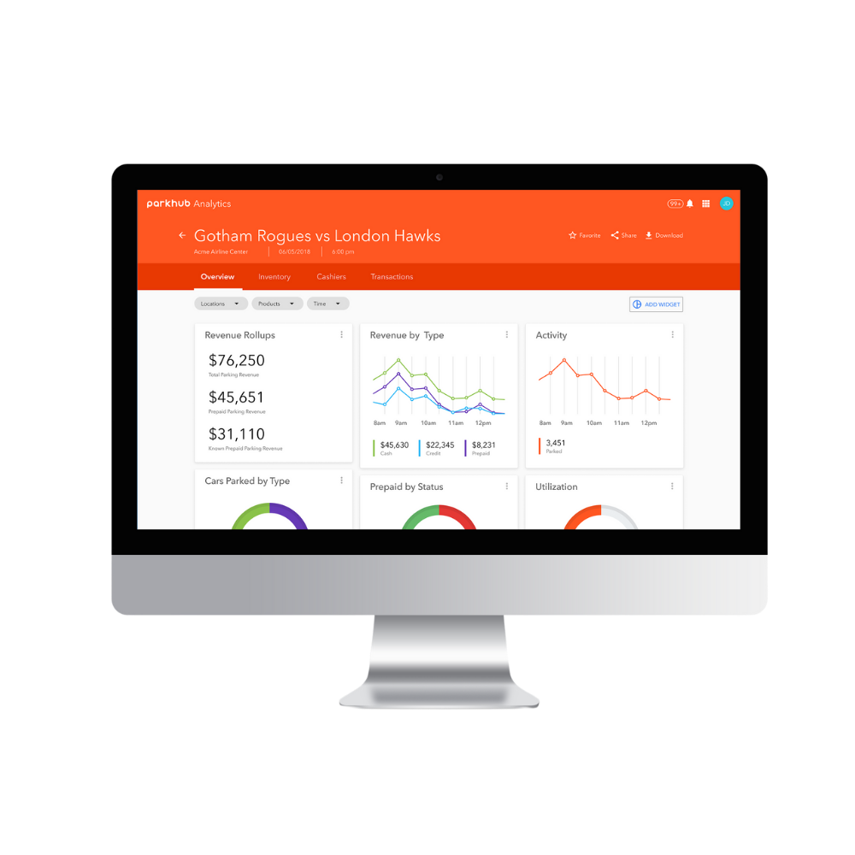
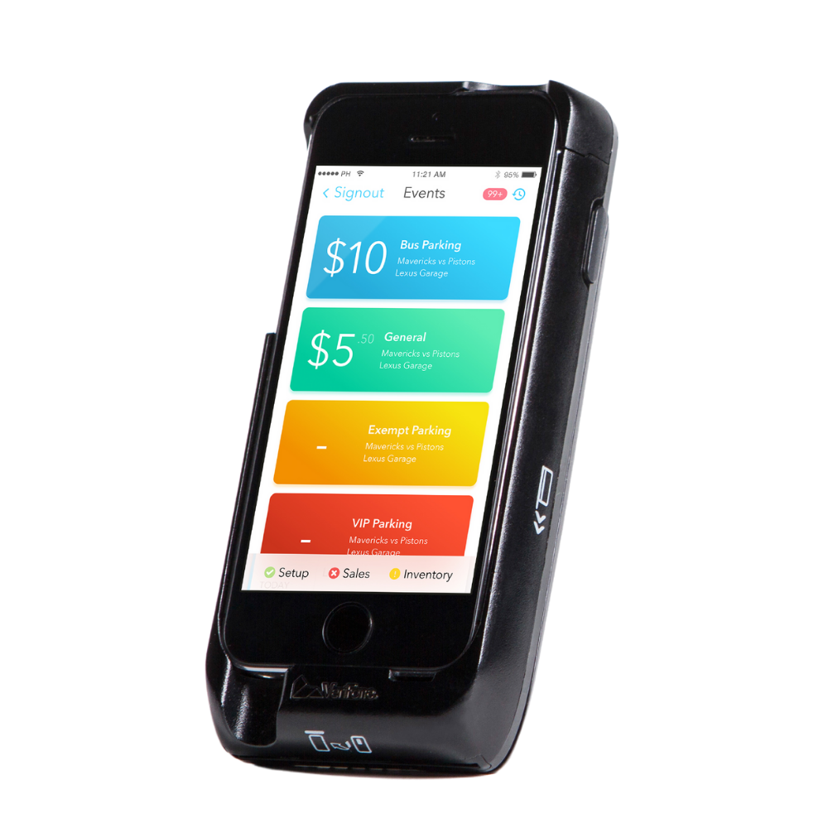
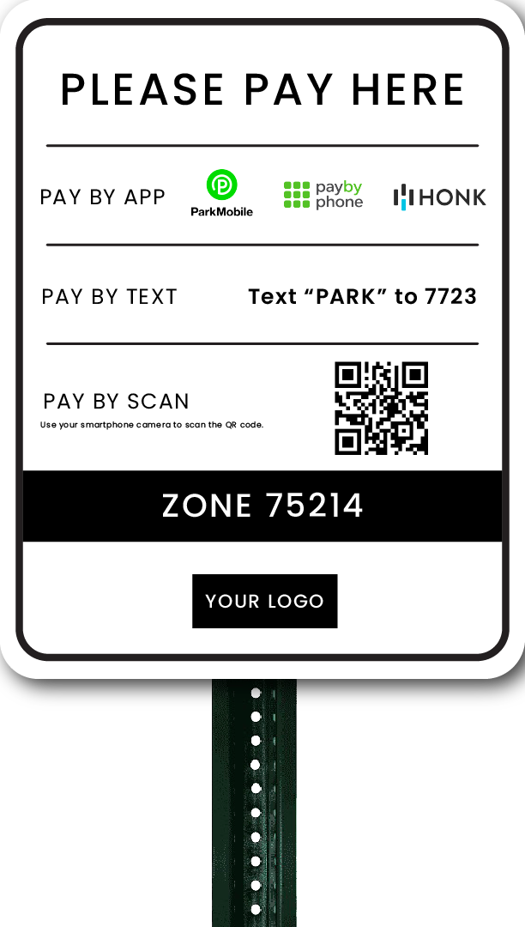
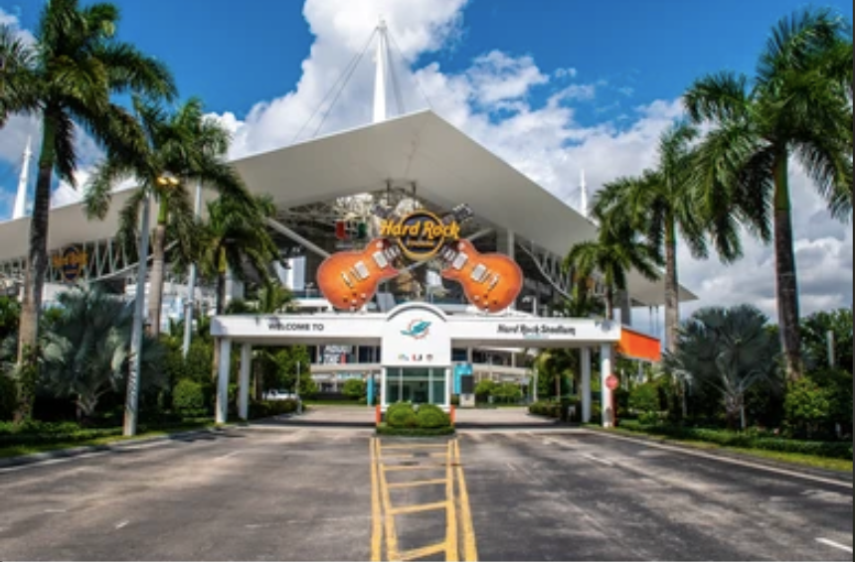
You say you want a revolution?
Beyond Mobile Ticketing | ParkHub
Prime
mobile point of sale
Suite
business intelligence
Pay&Go
QR-code reservations
Ancillary solutions
Integrated solutions

Slide 14
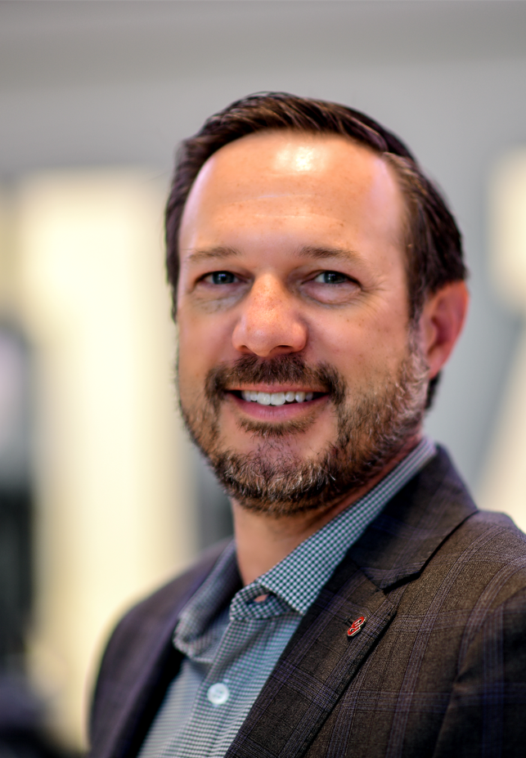
McK Williams
University of Oklahoma

Slide 15
Parking Lot Challenges
Donor lots were sold to capacity
Noticed that lots weren’t full for football and men’s basketball games
Looking for a solution that would provide scan data in parking lots

Slide 16
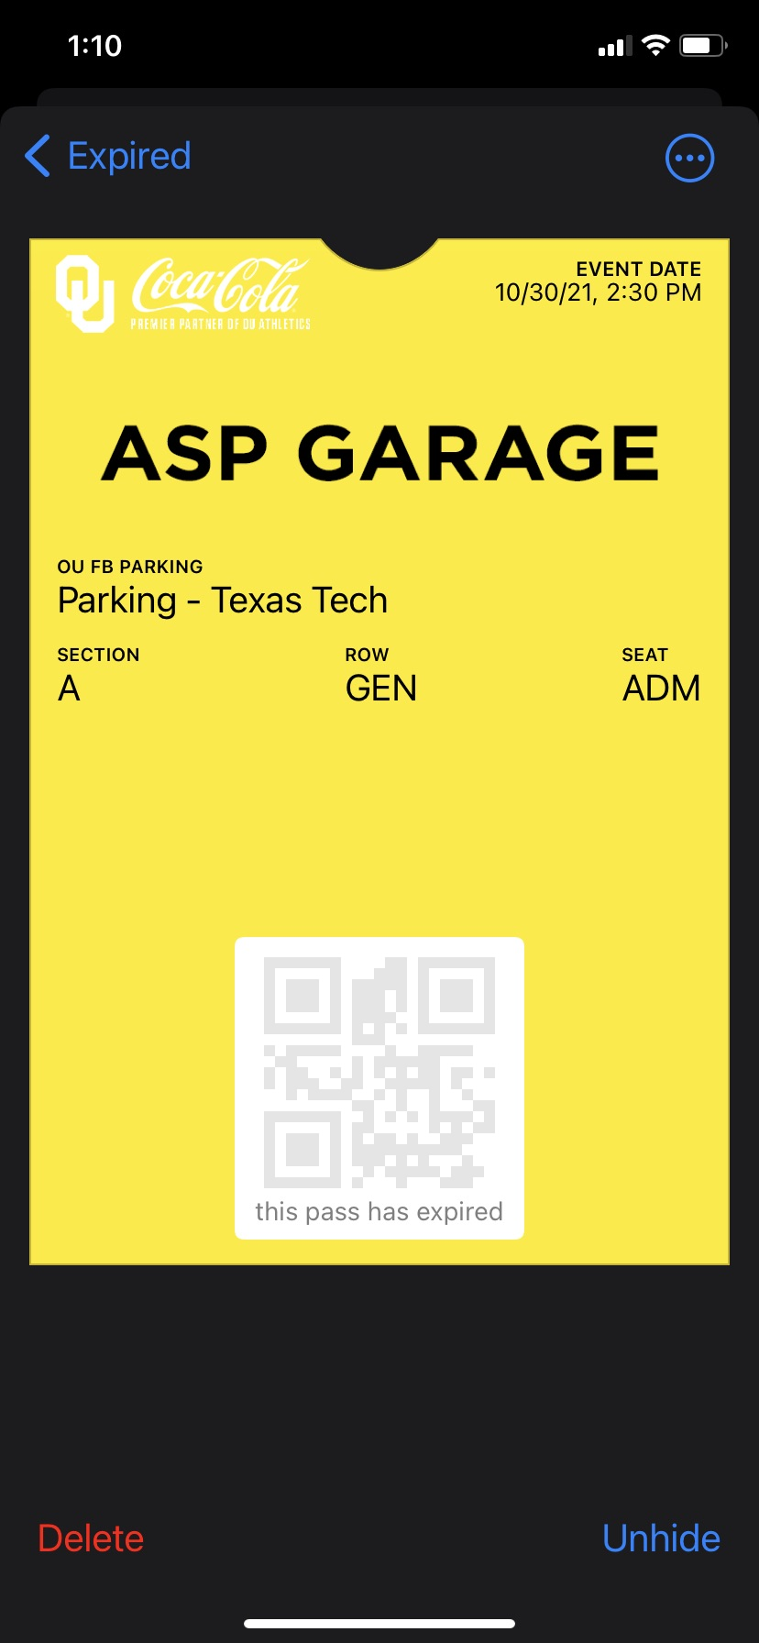
ParkHub Solution
Partnership with ParkHub entering the 2020 Football Season
2021 Football season back to full capacity, able to get scan data for parking lots
2,400 Passes – Distributed by Sooner Club
2,100 Passes – Paid Game Day Parking
Utilize platform to sell parking for special events on campus

Slide 17
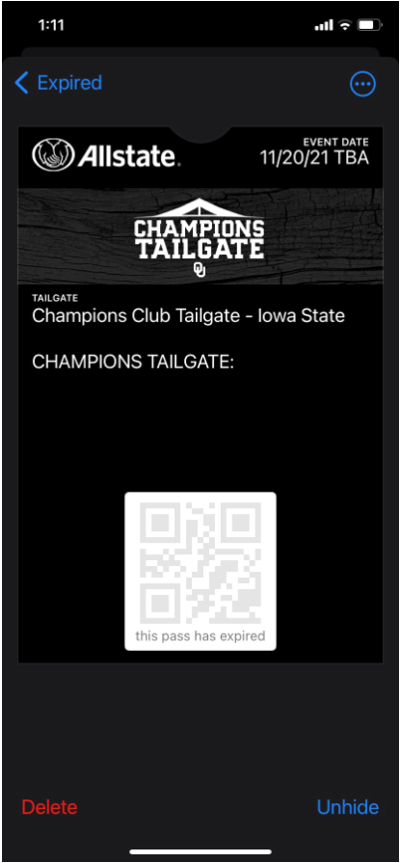
Hospitality Digital Pass and Scanning
Historically used wristbands for access to pre-game hospitality area
2021 football implemented digital hospitality passes delivered via ticketing system
Interested in scan data to track attendance
First attempted to use regular ticket scanners, however connectivity issues at hospitality area entrances
Through the ParkHub integration, able to use ParkHub devices to scan hospitality passes and track attendance
2,200 Hospitality Passes scanned on avg during FB season

Slide 18
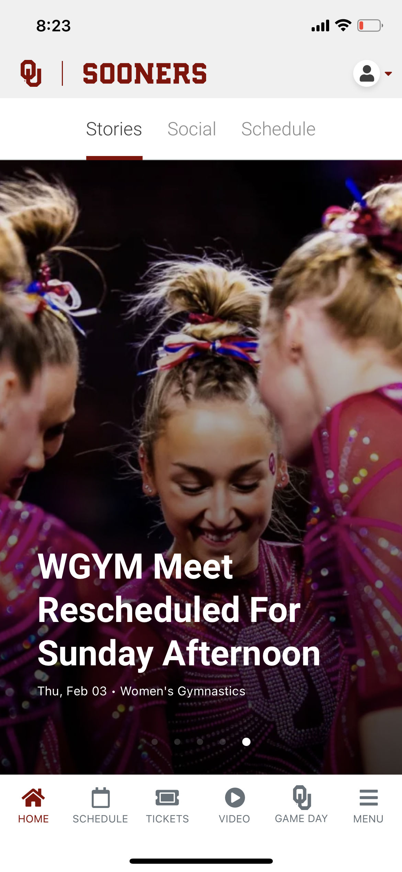
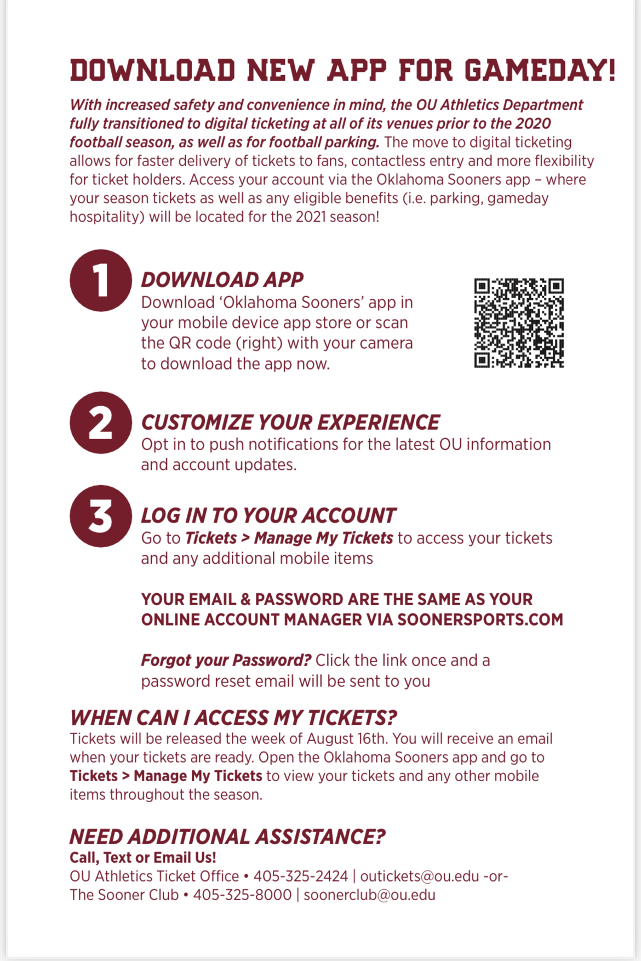
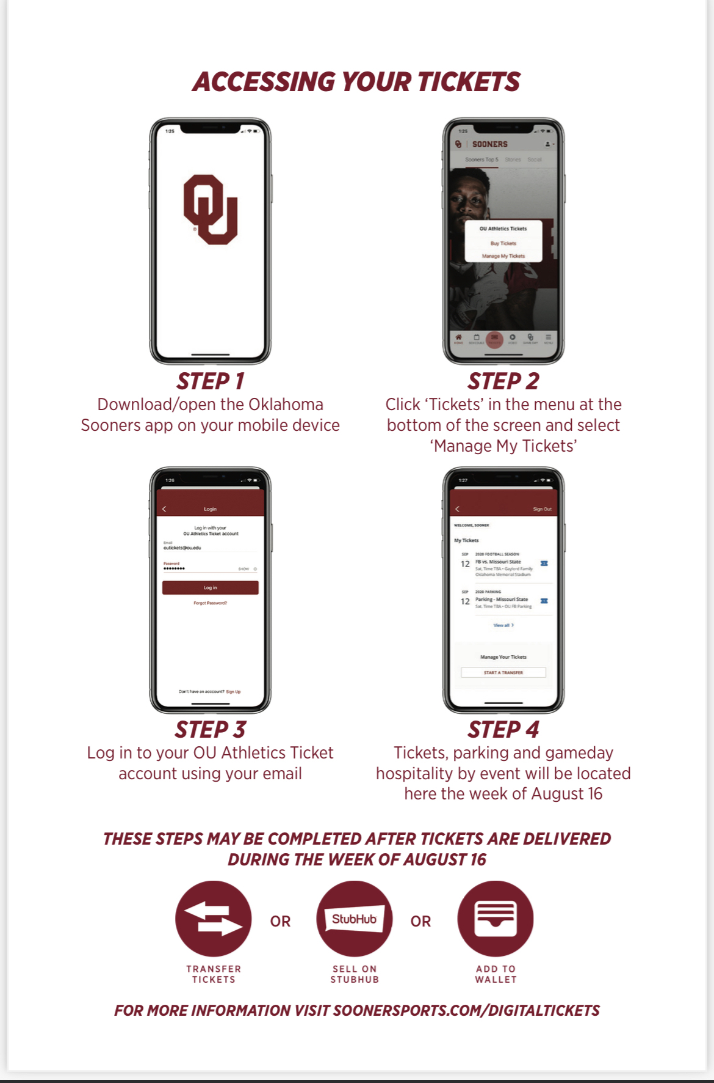
Additional Mobile Initiatives
Sidearm Mobile App
  Have digital tickets, parking, and hospitality pass all in one place for fans to manage
  Fan Education
Venue Next
  Allow fans to order concessions via the Sooner mobile app
  Placed a QR code on every seat in the stadium so fans could easily access the app

Slide 19
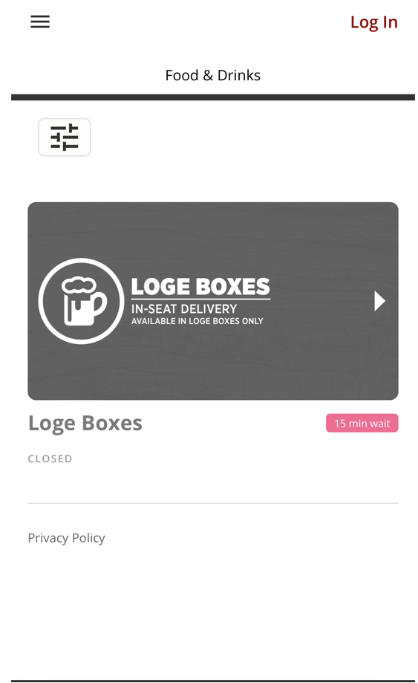
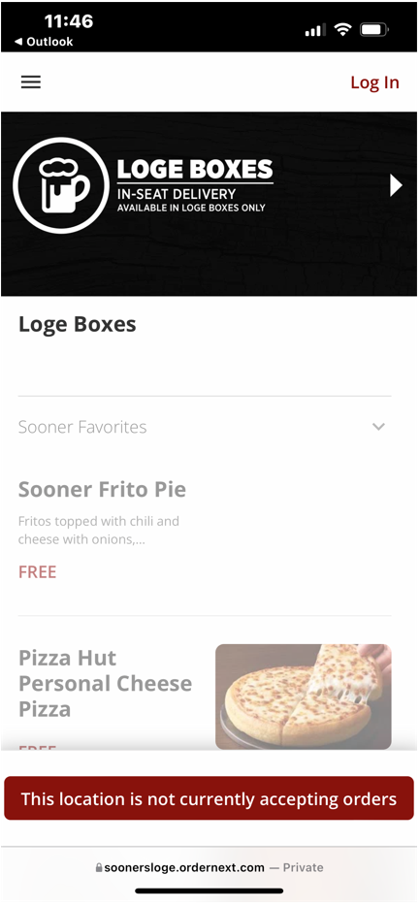

Concession Ordering Flow

Slide 20
THANK YOU!
QUESTIONS?
Please complete the online session evaluation.

